Slide 1

HOME SECURITY SYSTEM USING GSM
Presented by
ANANT KRISHNA - 1NH17EE003
JAYDEEP MAITY - 1NH17EE022
SANGAM JAIN - 1NH17EE050
Guide
Mr. VINOD KUMAR S
Senior Assistant Professor
EEE Dept., NHCE

Slide 2
INTRODUCTION
Home security has changed a lot from the last century and will be changing in coming years.
Security is an important aspect or feature in the smart home applications. The new and emerging concept of smart homes offers a convenient, and safe environment for occupants. Conventional security systems keep homeowners, and their property safe from intruders by giving the indication in terms of short message. However, a smart home security system offers many more benefits.
The main concept the project is aimed towards all the average domestic users who wish to control their household remotely by their cell phones.

Slide 3
LITERATURE SURVEY
Android mobile based home security and device control using GSM
Author(s): -
S. Rajadurai ; P. P. Nehru ; R. Selvarasu
Abstract:
A home automation technique based on ARM controller. This technique uses an IR sensor to detect the person. If the IR sensor detects a person then the keypad will be activated to enter the pass code. A SMS will be sent to the owner for authentication. Depending on the owner's replay the door will open. If the person enters a wrong password, an intimation message will be sent to the owner and at the mean time buzzer will be activated. Android application is used to control the electrical appliances. The firmware for this paper is written in embedded `C' language and the machine codes for the program are stored in the non-volatile flash memory of the embedded controller.
Date Added to IEEE Xplore: 13 August 2015
INSPEC Accession Number: 15366771
Publisher: IEEE
A low-cost GSM/GPRS based wireless home security system
Author(s): -
Yanbo Zhao ; Zhaohui Ye
Abstract:
Home security system is needed for occupants' convenience and safety. In this paper, we present the design and implementation of a low cost, low power consumption, and GSM/GPRS (global system for mobile communication /general packet radio service) based wireless home security system. The system is a wireless home network which contains a GSM/GPRS gateway and three kinds of wireless security sensor nodes that are door security nodes, infrared security nodes and fire alarm nodes. The nodes are easy installing. The system can response rapidly to alarm incidents and has a friendly user interface including a LCD (liquid crystal display) and a capacitive sensor keyboard. The wireless communication protocol between the gateway and the nodes is also suitable for other home appliances. Furthermore, some methods are taken to ensure the security of system information.
Date Added to IEEE Xplore: 15 July 2008
INSPEC Accession Number: 10090639
Publisher: IEEE

Slide 4
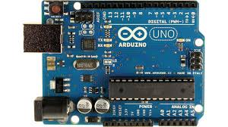
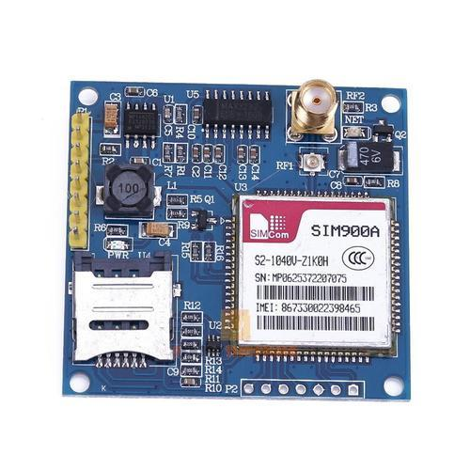
COMPONENTS REQUIRED
ARDUINO UNO
SIM 900A GSM MODULE

Slide 5
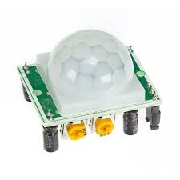
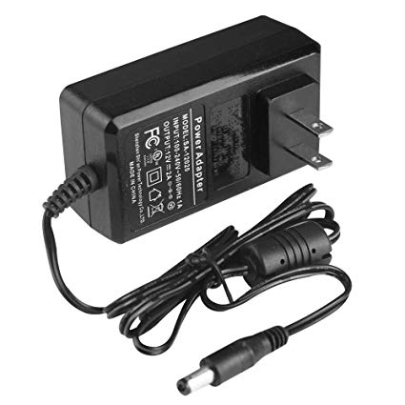
PIR SENSOR
12V POWER SUPPLY

Slide 6
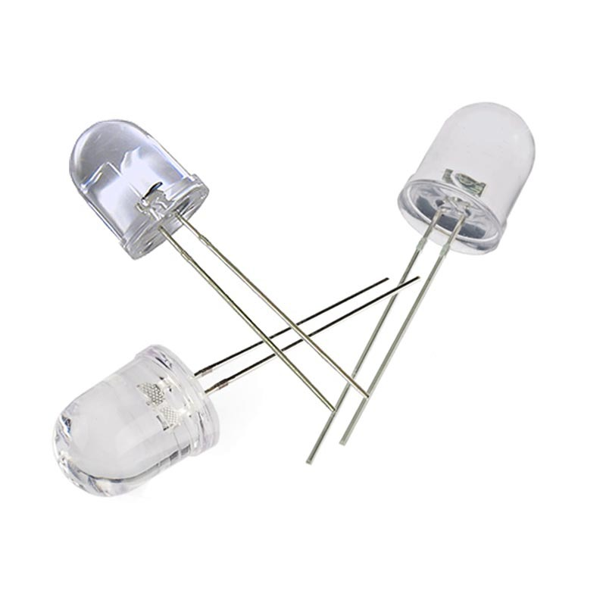
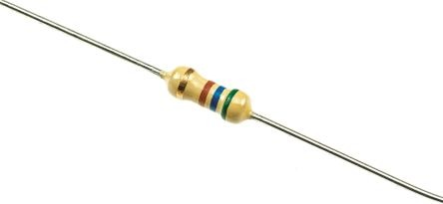
LED
RESISTOR

Slide 7
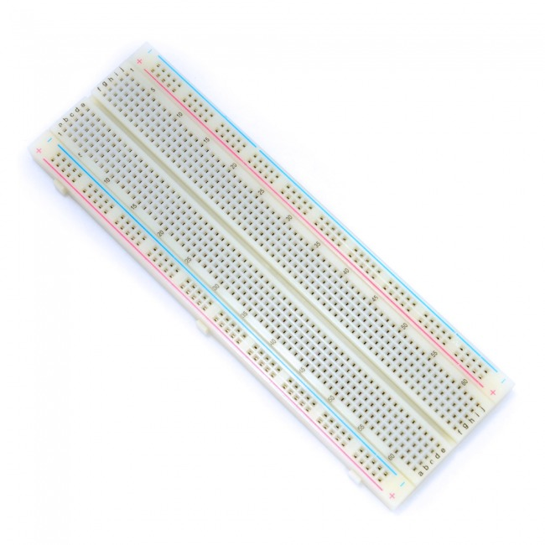
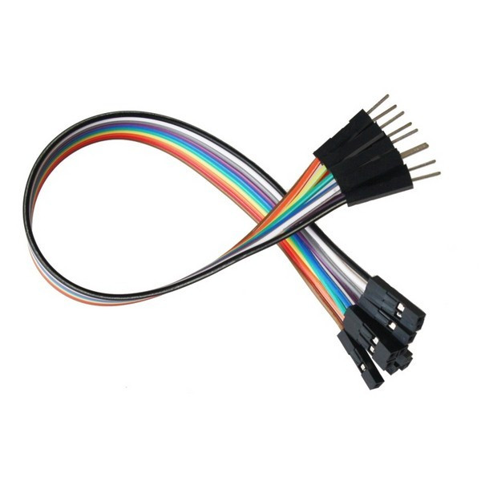
BREADBOARD
JUMPER WIRES

Slide 8
PROPOSED METHODOLOGY
A. METHODOLOGY:
This system is constructed with Arduino that contains the code for the specific action. The PIR sensor will sense the movement and will alert the GSM modem i.e. to alert the owner about intruder or danger to the house. The GSM after being triggered through Arduino, sends a text message to the to alert the owner and later places a call through the GSM module.

Slide 9
B.ALGORITHIM:
First two LEDS are used to determine the working of PIR sensor and any movement around the sensor.
The output of PIR sensor is set to low.
Check the condition, When the output of PIR sensor is high, LED 2 also becomes high, which triggers the microcontroller and makes a call to the number written in the program through GSM module.
C.PROGRAM:
program 2.pdf

Slide 10
BLOCK DIAGRAM
PIR Sensor
Arduino UNO
GPRS shield
Mobile
External movement
12V supply

Slide 11
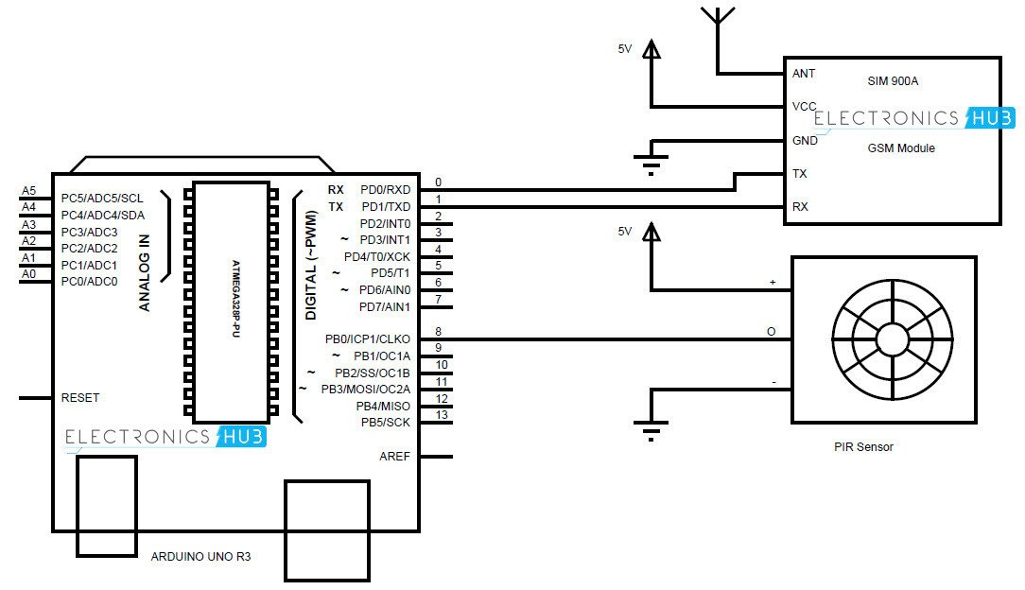
CIRCUIT DIAGRAM

Slide 12
WORKING
First LED is used to determine that PIR sensor is initiated.
Second LED is used to determine, any motion detected by PIR sensor.
The Input from the PIR sensor is send to the Arduino.
Arduino, then communicates with the GSM module through serial communication.
GSM module makes a call and sends SMS to the programmed Mobile number and alert the owner.

Slide 13
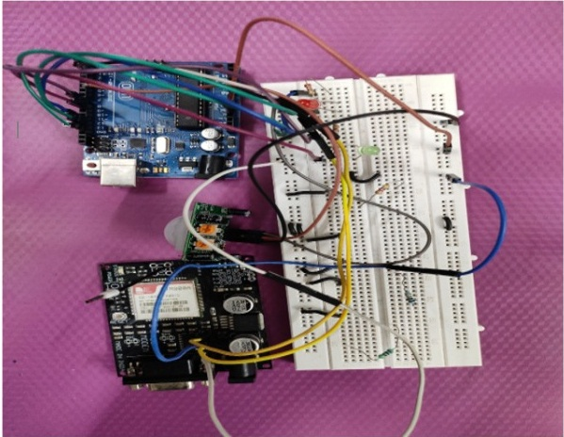
Diagram

Slide 14
OUTPUT
When any intruder enters the house in the absence of the owner, the movement is detected by PIR sensor, and the user gets a call or a text message on his/her mobile phone, thus warning the user that somebody has entered the house in his absence.

Slide 15
PROBLEMS FACED
Although the PIR sensor is sensing the movement and triggering the microcontroller, there are some issues with the GSM module.
The GSM module is not able to make call or send the text message on the phone.

Slide 16
THANK YOU

